Slide 1
OP-AMP Design
ECEE 421
Ho Wang Lam

Slide 2
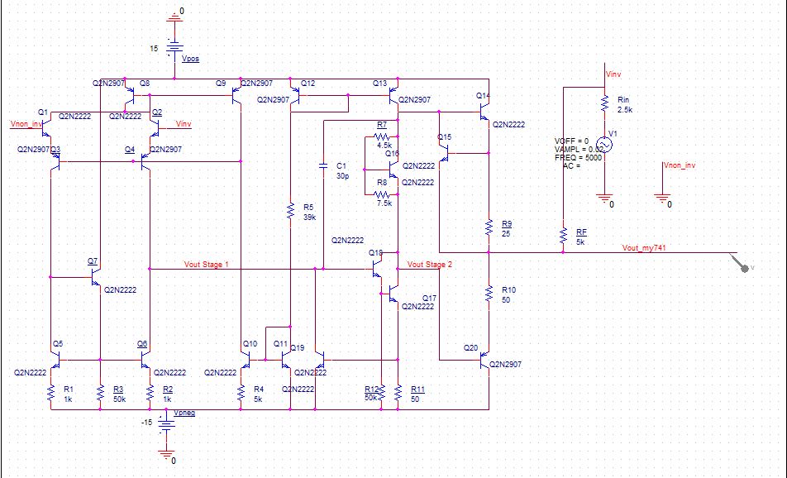
Overview and Intro
Reconstructing the LM741 with npn 2N2222 and pnp 2N2907 and analog parts
Assuming electrical characteristics (Early voltage, beta, reverse saturation current of transistors, etc.) of the components are similar to the real npn 2N2222 and pnp 2N2907

Slide 3
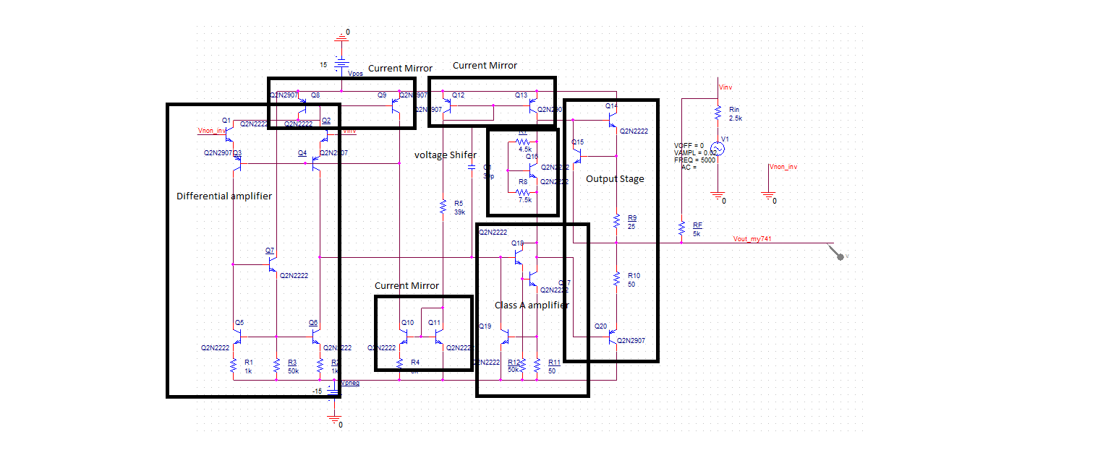
Circuit Breakdown

Slide 4
Setup
Vin of 40mVpp sin wave at 5000Hz
V+ of 15V
V- of -15V
Rf = 5k
Rin = 2.5k
Expecting gain:
Rf/Rin = -2 V/V

Slide 5
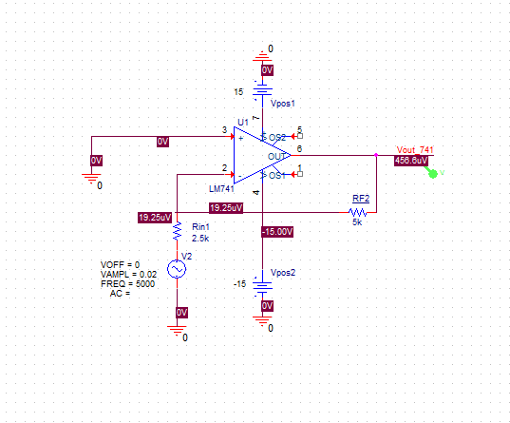
Compare to real LM741

Slide 6

Bias Circuit– Referent Current
Two diode-connected transistors Q11 and Q12 and the resistance R5
Create a Iref in the center and other stages can use this and current mirrors to refence them self

Slide 7
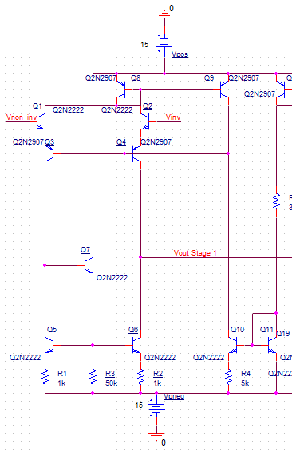
Input stage - Differential Input
Q10 mirrors Q11 and delivers it to Q3 and Q4 base
Q1 and Q2 act as emitter followers, causing the input resistance to be high and delivering the differential input
Q3 and Q4 act as differential common-base amplifier and delivering to loading circuit.
Q5, Q6, and Q7 and resistors R1, R2, and R3 form the load circuit of the input stage.
Provides gain
Output is taken at Q6 collector

Slide 8
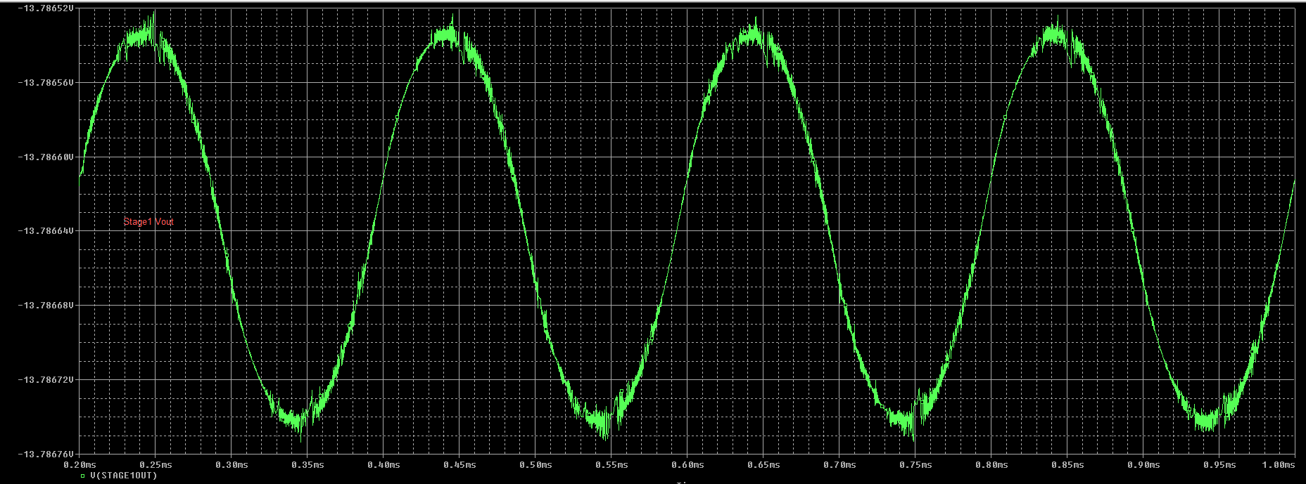
Stage 1 output – 40mVpp input

Slide 9
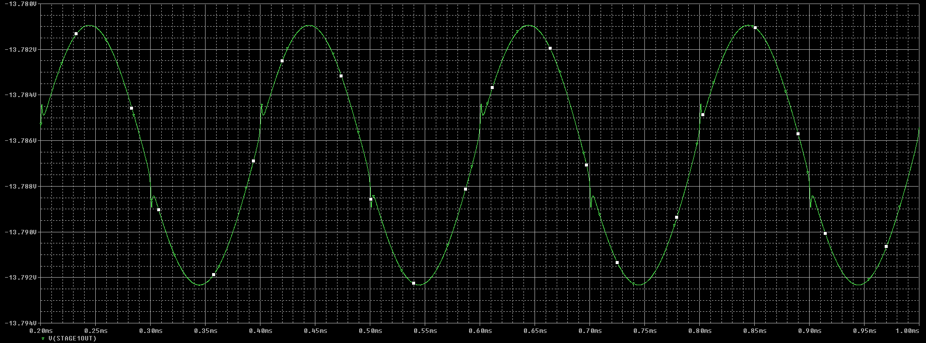
Stage 1 output 2Vpp input

Slide 10
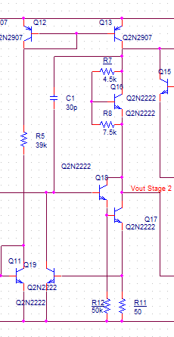
Voltage Gain Stage - 1
Signal from Stage 1 is feed into Q18 base
Q17, Q18 form a Darlington pair to achieve and bate^2 and have a high gain
Q18 is emitter follower
High Rin
Prevent gain loss
Q17 common emitter amplifier
Load of Q17 is active load formed by pnp Q12, Q13

Slide 11

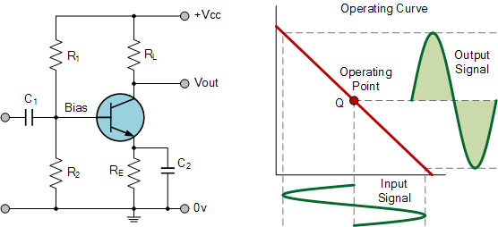
Voltage Gain Stage - 2
The Darlington Pair with active load forming a Class A amplifiers
Q12,Q13 Current mirror acting as active loading to achieve high resistance
Rout of the current mirror:
Q17, Q18 form a Darlington pair to achieve and bate^2 and have a high gain
Example of Class A amplifier
Source: www.electronics-tutorials.ws

Slide 12
Voltage Gain Stage - 3
30pF cap is feedback know as Miller compensation and create a dominant pole compensation and give a pole as low as 10 Hz -3dB cutoff
Output of gain stage is at Q17 collector

Slide 13
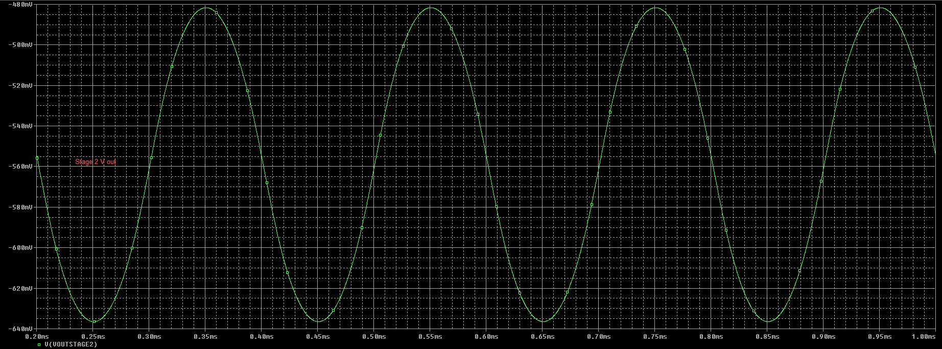
Stage 2 output

Slide 14
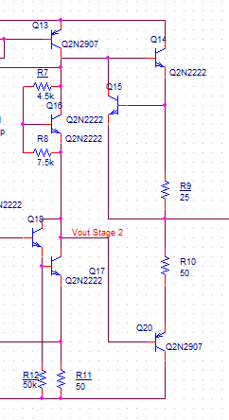
Output Stage - 1
Goal of the stage is to provide a low Rout and able to supply a large load current
Class AB output stage formed by Q14 and Q20 and bias by Q16 and R7 and R8
Output of the OPAMP is between R9, R10
Ideally Q14, Q20 should have a larger area for supplying higher loading current and minimal temperature effect

Slide 15
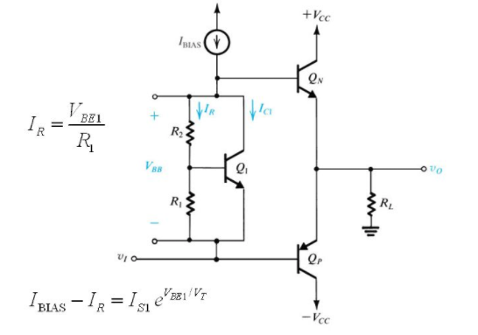
Class AB output stage example

Slide 16
Output Stage - 2
Short circuit protection Q15 limit the current go to Q14
The book example has a extra pnp to protect Q20, however on the datasheet the protection for the sink does not exist

Slide 17
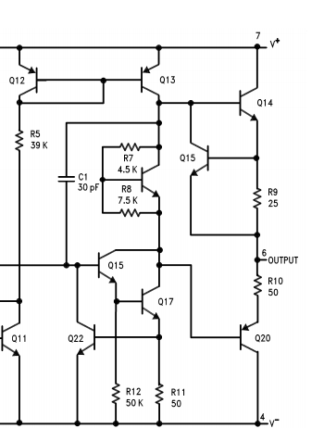
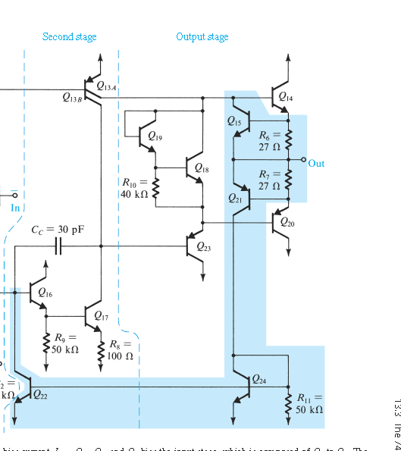
Difference between textbook and datasheet

Slide 18
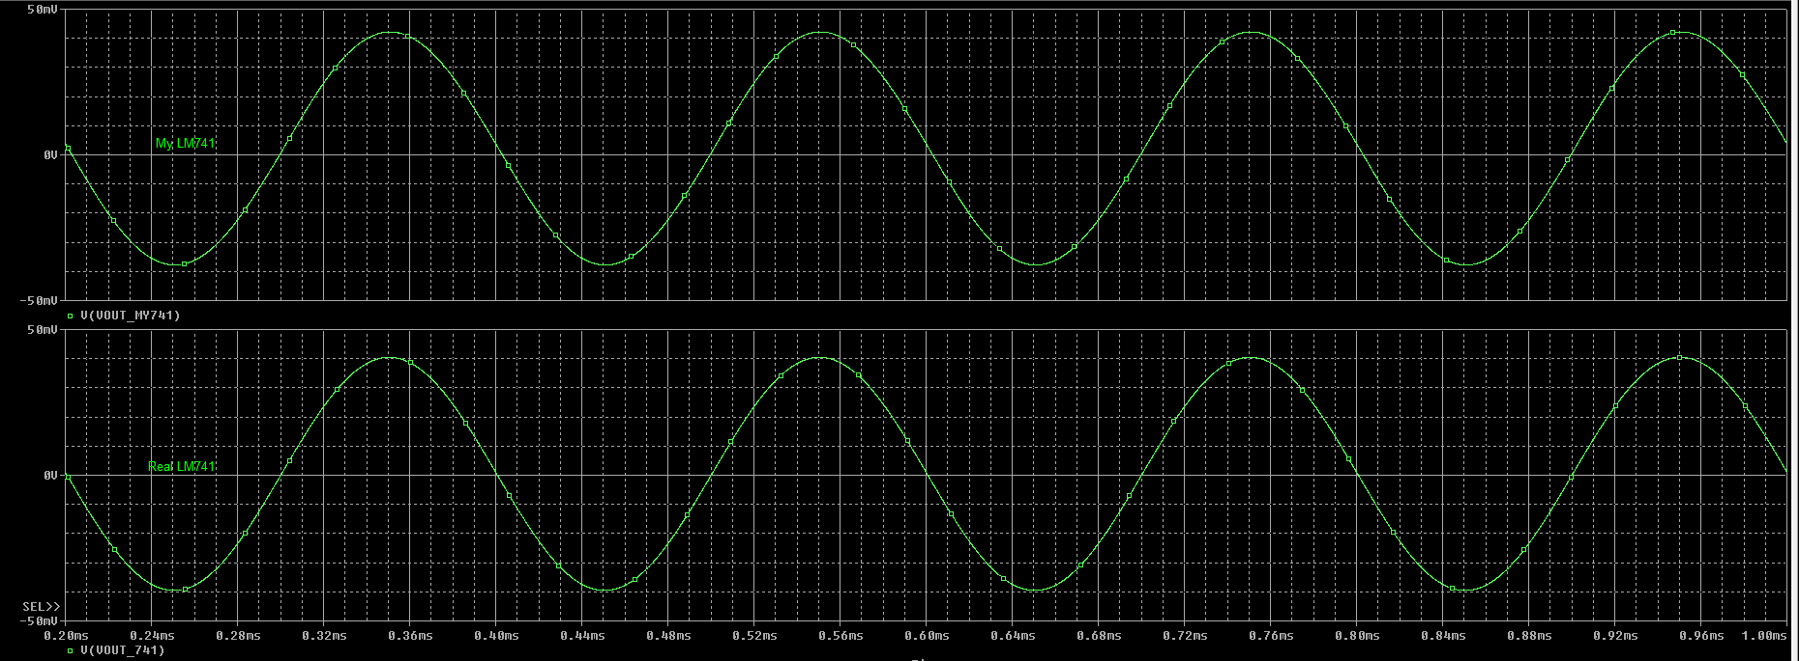
Performance Compare – 40mVpp Input 0V offset Application In An Inverting Amplifier

Slide 19
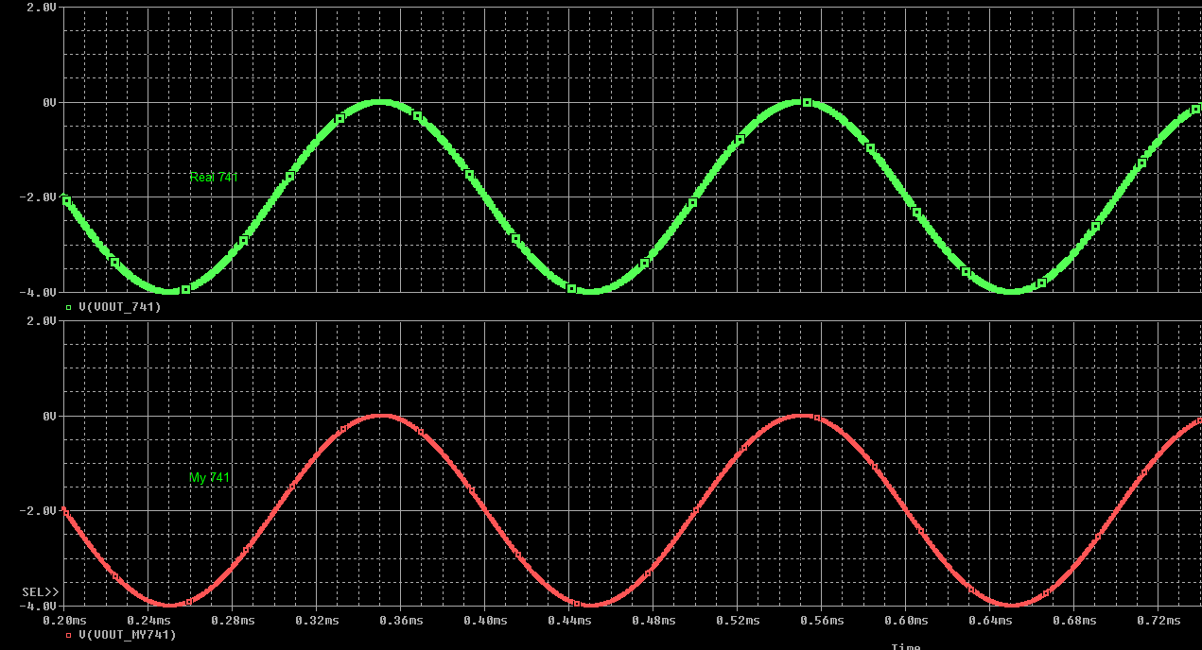
Performance Compare – 2Vpp Input 1V offset Application In An Inverting Amplifier Rf 5K Rin 2.5k

Slide 20
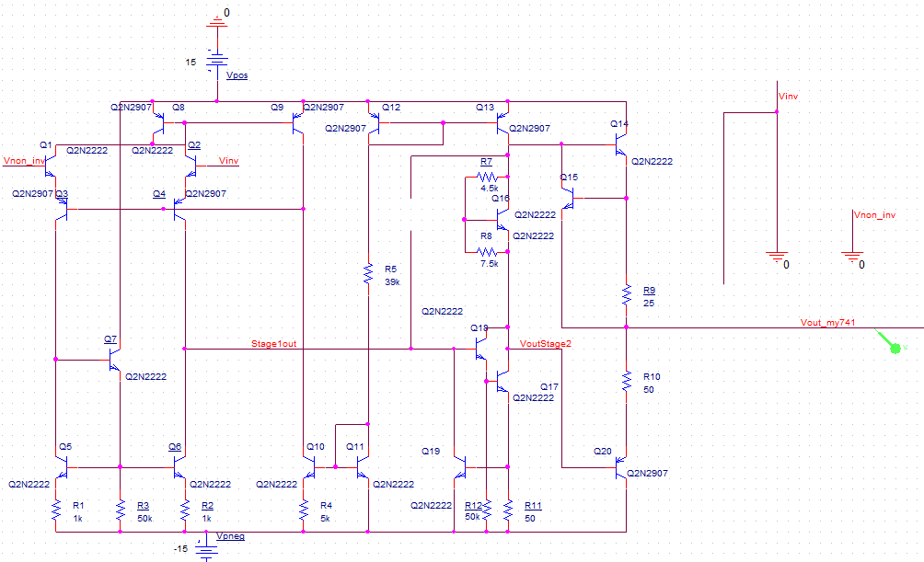
DC analysis - 1
Caps are open circuits
Short all input signals

Slide 21
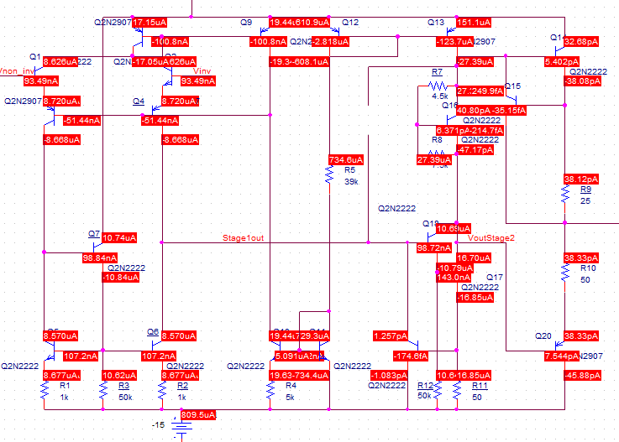
DC analysis - 2

Slide 22
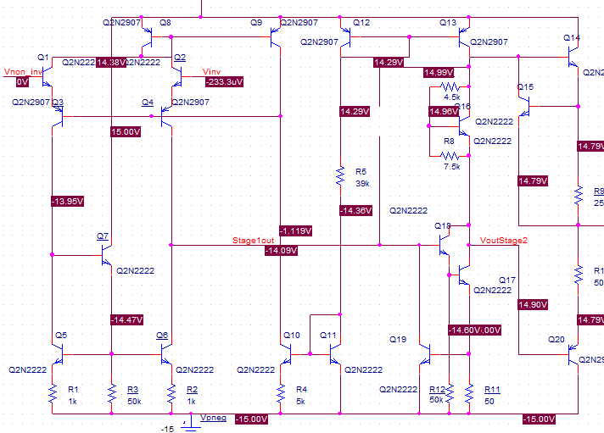
DC analysis - 3

Slide 23
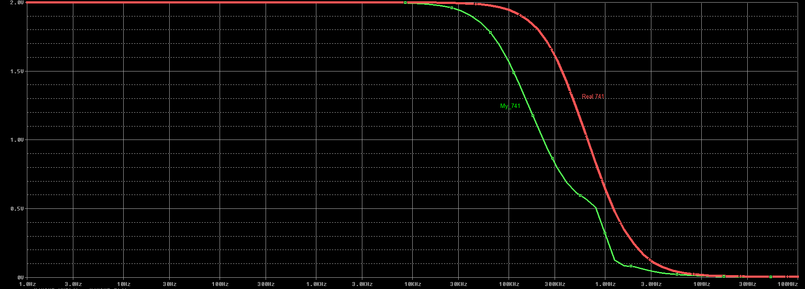
Performance Compare - Frequency Response

Slide 24
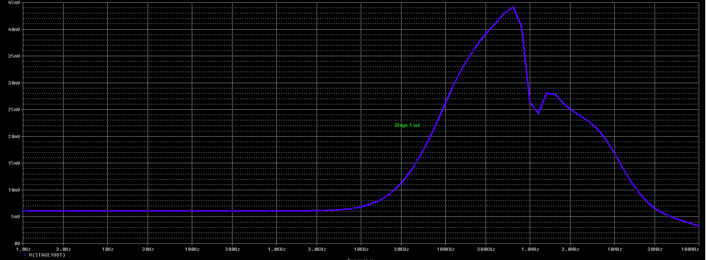
Performance Compare - Frequency Response Stage 1

Slide 25
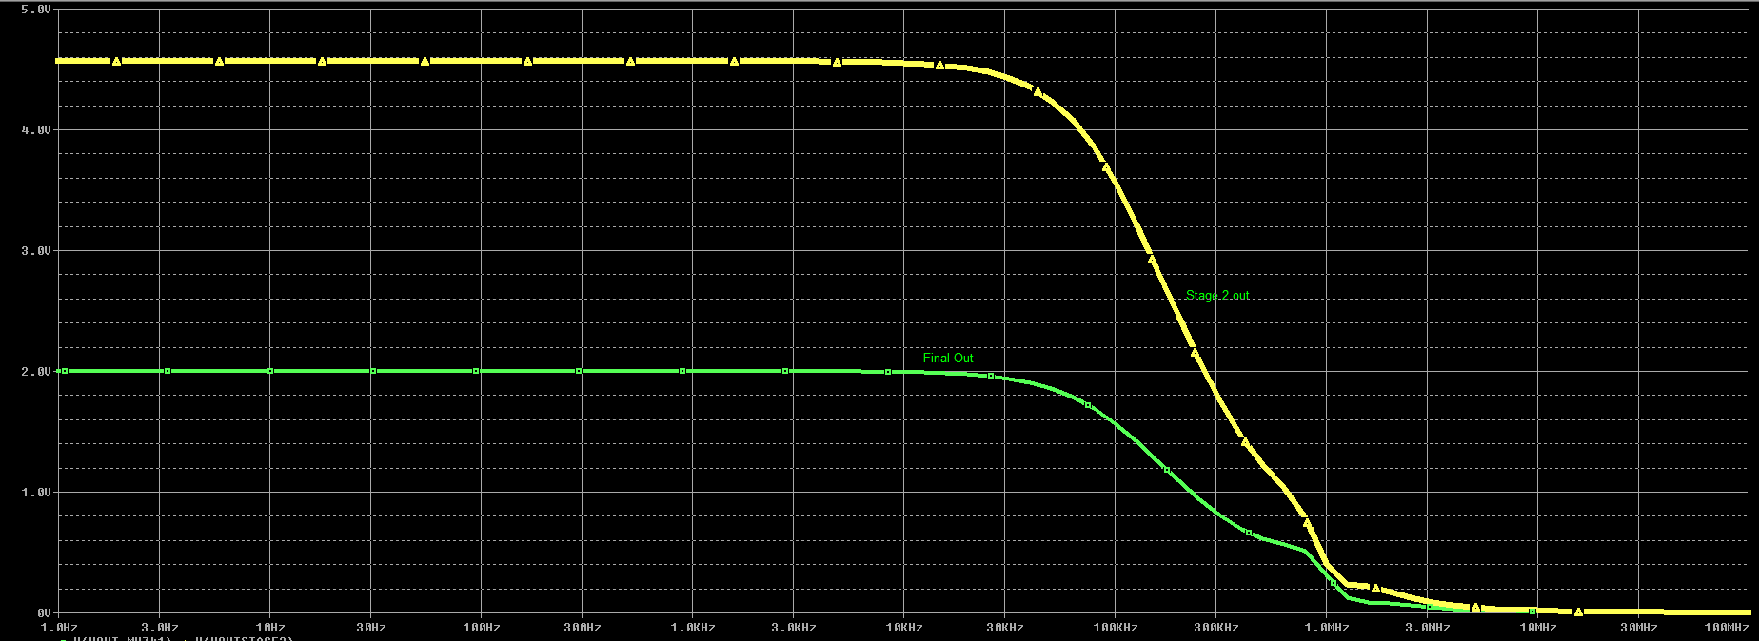
Performance Compare - Frequency Response Stage 2

Slide 26
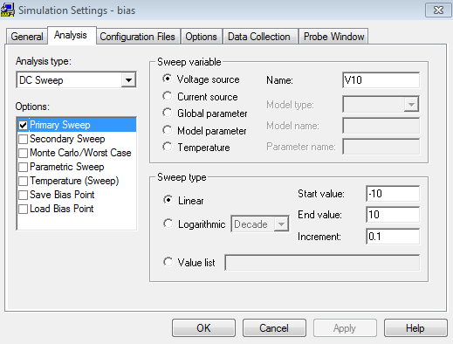
Performance Compare - Voltage Swing
DC vin from -10 to 10
Expecting gain of -2 since Rf/ Rin = 5k/2.5k

Slide 27
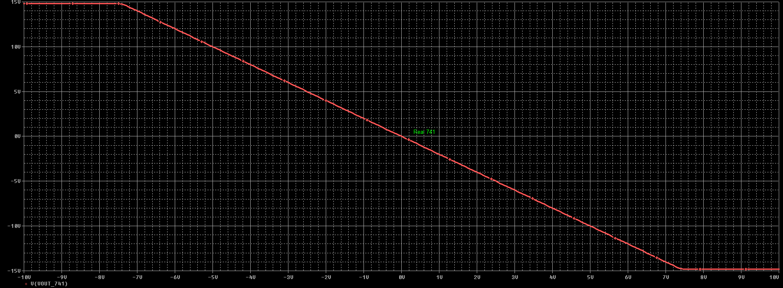
Performance Compare - Voltage Swing

Slide 28
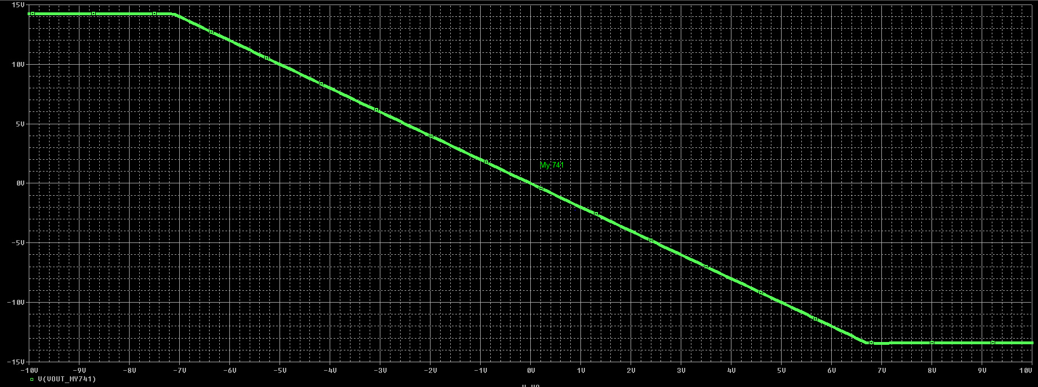
Performance Compare – Voltage Swing My 741

Slide 29
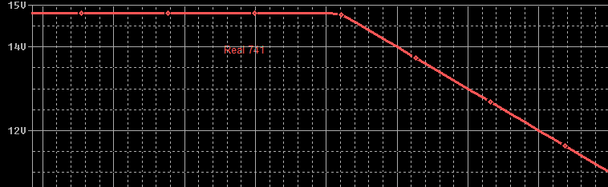
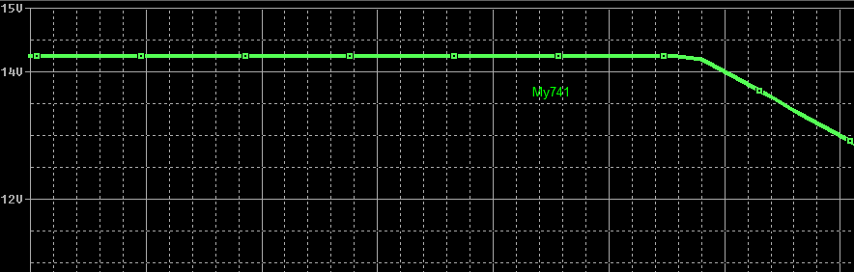
Performance Compare – Voltage Swing Zoomed In
DC vin from -10 to 10
Expecting gain of -2 since Rf/ Rin = 5k/2.5k
Not as good as real 741 but still within datasheet range

Slide 30
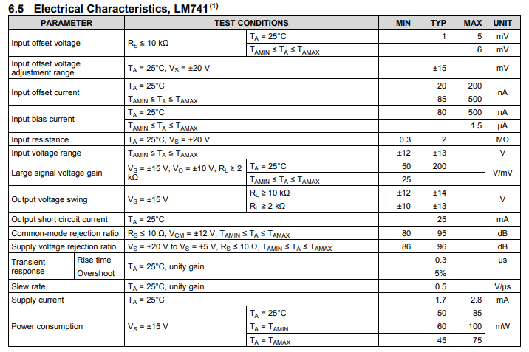
Electrical Characteristics

Slide 31
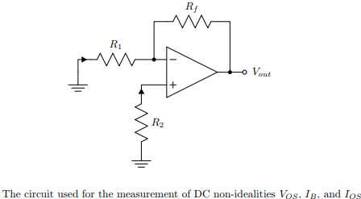


Input offset Input offset voltage Vos - 2

Slide 32
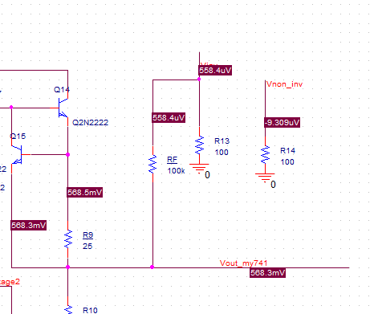
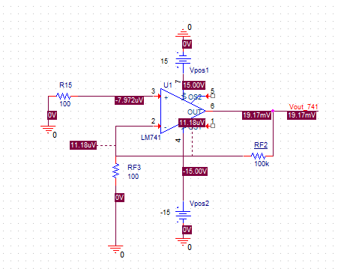
Input offset voltage Vos - 2
My 741 Vos = 568.3mV / 2 = 284mV
Real 741 Vos = 19.17mV / 2 = 9.58mV

Slide 33


Input Bias Current, Positive Terminal, I_{B2} - 1

Slide 34
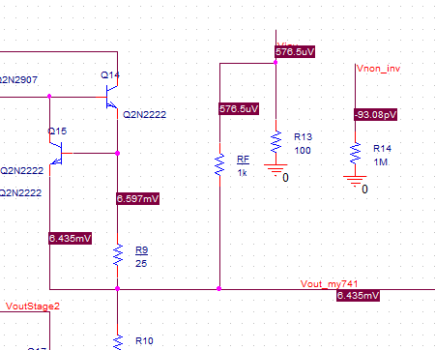
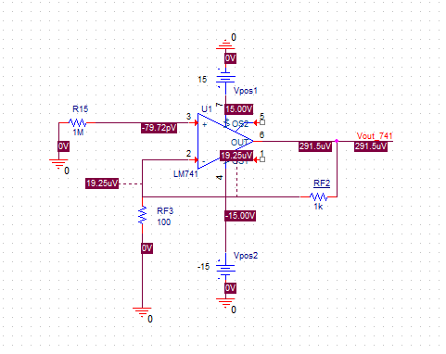
Input Bias Current, Positive Terminal, I_{B2} - 2
My 741 Ib2 = -93.08pV / (1M(1+1k/100)) = 8.4uA
Real 741 Ib2 = 291.5uV / (1M(1+1k/100)) = 26.5pA

Slide 35
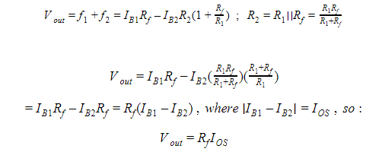
Input Offset Current I_{OS} - 1

Slide 36
Input Offset Current I_{OS} -2
The datasheet value for IOS is given as typically 2 nA and maximum 20 nA under ideal temperature conditions. Using this value, the maximum value of Vout can be calculated given that Rf =1 MΩ.
Vout = Rf (IOS)
Voutmax = (1 MΩ)(20 nA) = 20 mV
The computed value of IOS was calculated using the measured Vout of the circuit with R1=100 kΩ, Rf=1 MΩ, and R2=R1||Rf=91 kΩ

Slide 37

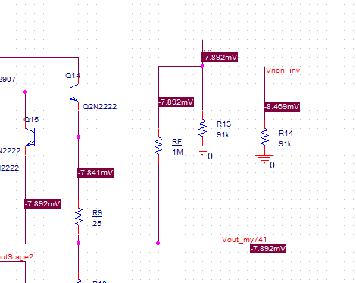
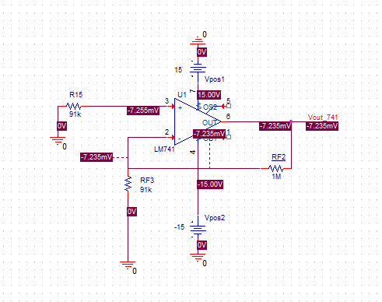
Input Offset Current I_{OS} - 3
The datasheet Ios: Typical 2 nA and maximum 20 nA
My 741 Ios = -7.892mV/1M = 7.89nA
Real 741 Ios = -7.235mV/1M = 7.24nA

Slide 38
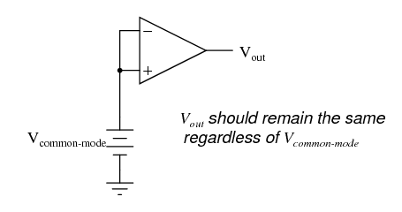

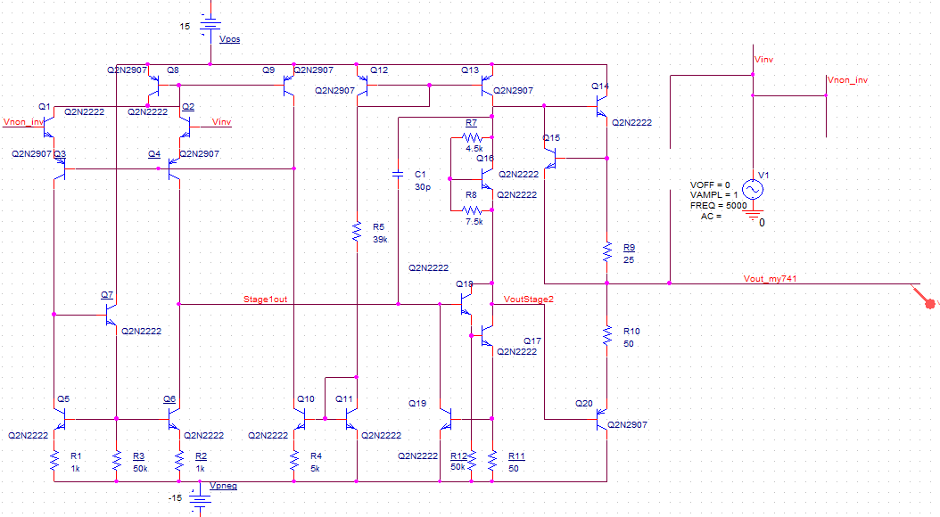
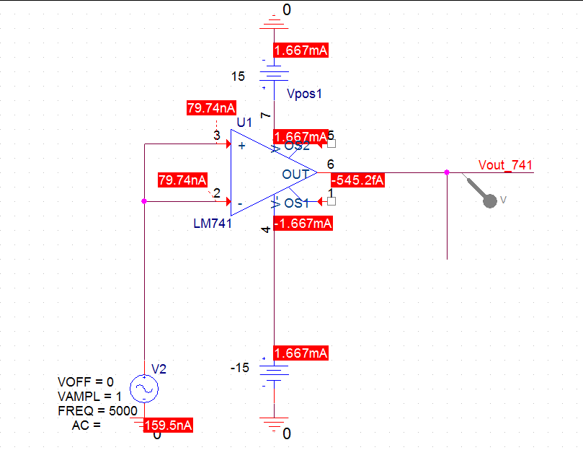
Common mode Rejection

Slide 39
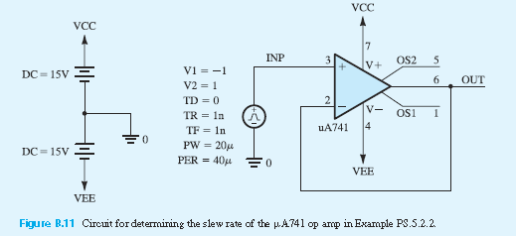
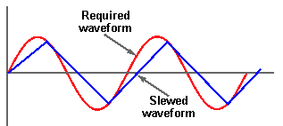
Slew Rate
Slew Rate = 2* π *f*V
f = the highest signal frequency, Hz V = the maximum peak voltage of the signal
Cutoff around 33kHz
2 π x 33 000 x 2 = 0.414744 V/µs

Slide 40
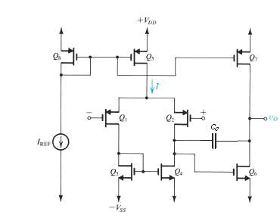
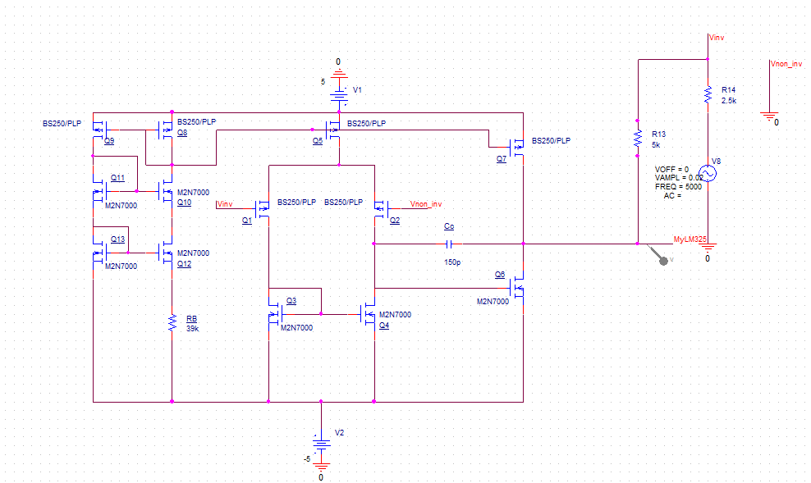
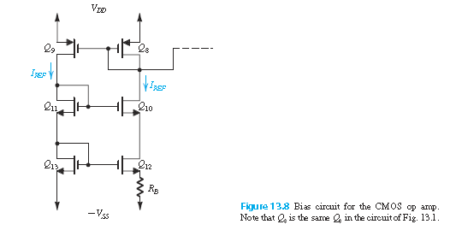
CMOS low power OPAMP

Slide 41

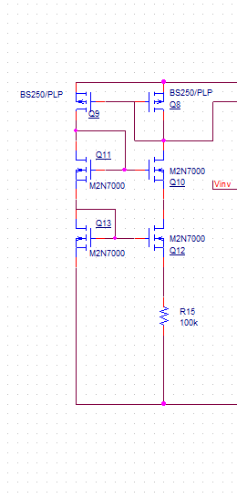
Bias circuit

Slide 42
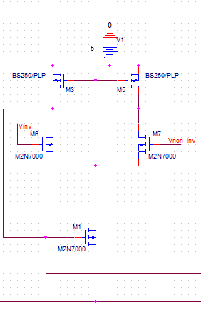
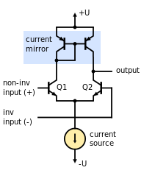
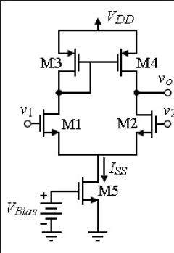
Input stage - Differential Input -1

Slide 43
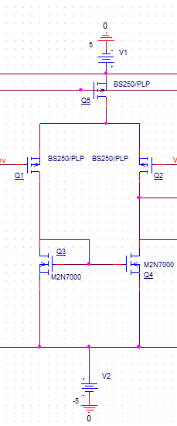
Input stage - Differential Input
Biased by current source Q5
Differential pair Q1–Q2
Current-mirror load Q3–Q4

Slide 44
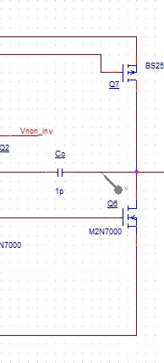
Out put Stage – Common-Source Amp
common-source transistor Q6
current-source load Q7.
frequency compensating the op amp Cc

Slide 45
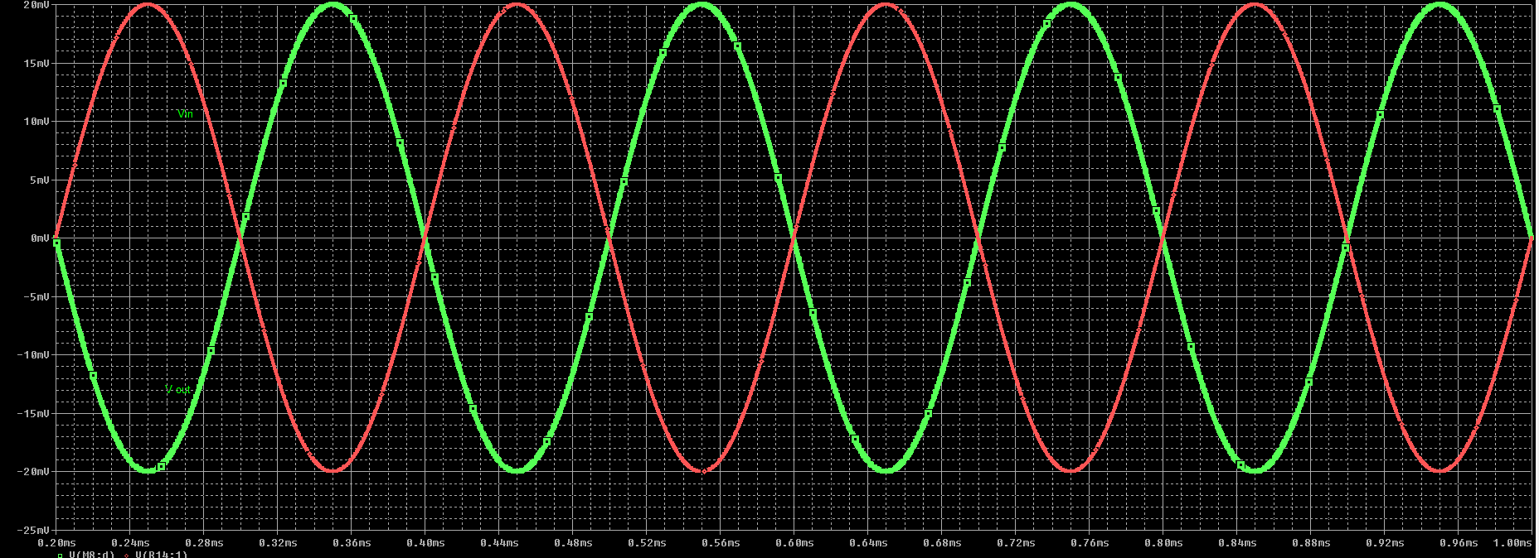
Output Rf = 5k, Rin = 5k, Vin 40mVpp

Slide 46

Output Rf = 5k, Rin = 2.5k, Vin 40mVpp

Slide 47

Performance - Frequency Response

Slide 48

Performance - Voltage Swing

